Slide 1
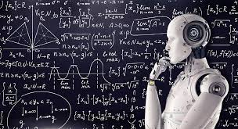
MACHINE LEARNING

Slide 2
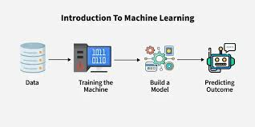
Machine learning is a subfield of artificial intelligence that uses algorithms trained on data sets to create models capable of performing tasks that would otherwise only be possible for humans, such as categorizing images, analyzing data, or predicting price fluctuations. Today, machine learning is one of the most common forms of artificial intelligence and often powers many of the digital goods and services we use every day.

Slide 3
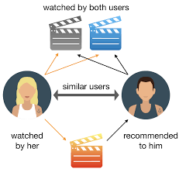
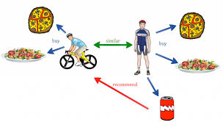
EXAMPLES
Recommendation engines that suggest products, songs, or television shows to you, such as those found on Amazon, Spotify, or Netflix.
Speech recognition software that allows you to convert voice memos into text..
Self-driving cars and driver assistance features, such as blind-spot detection and automatic stopping, to improve overall vehicle safety.

Slide 4
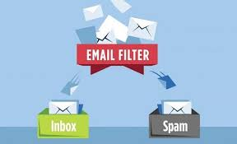
TYPES OF ML
Supervised Learning:
The computer learns from examples that are already labeled with the correct answers.
Example: Spam email detection, where emails are labeled as spam or not spam.

Slide 5
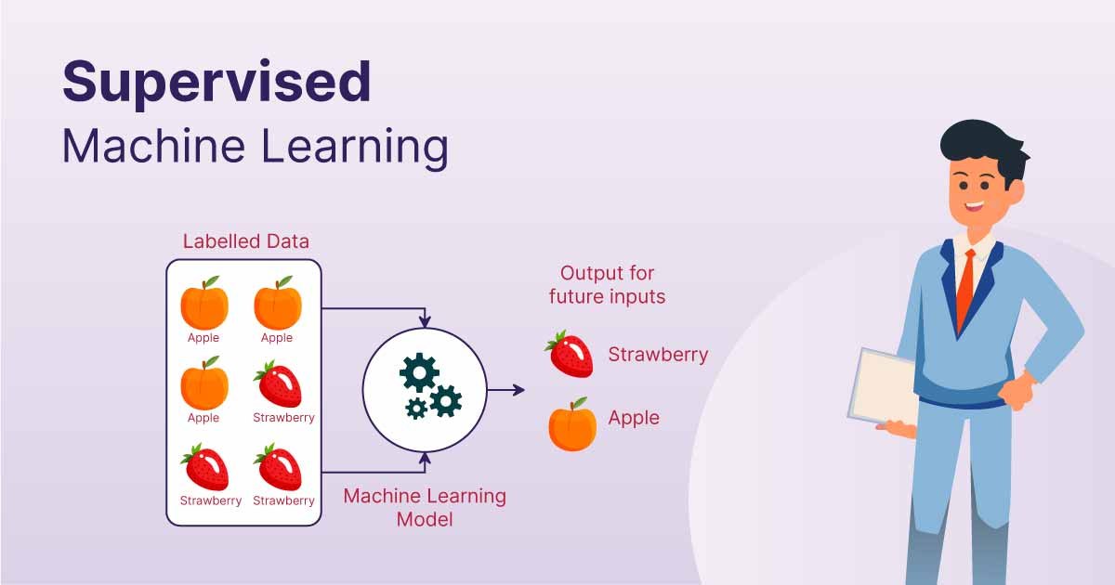

Slide 6
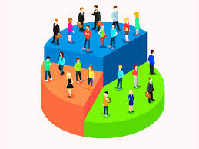
Unsupervised Learning:
The computer looks at data without any labels and tries to find patterns or groups on its own.
Example: Customer segmentation, where you group people into different categories based on buying behavior.

Slide 7
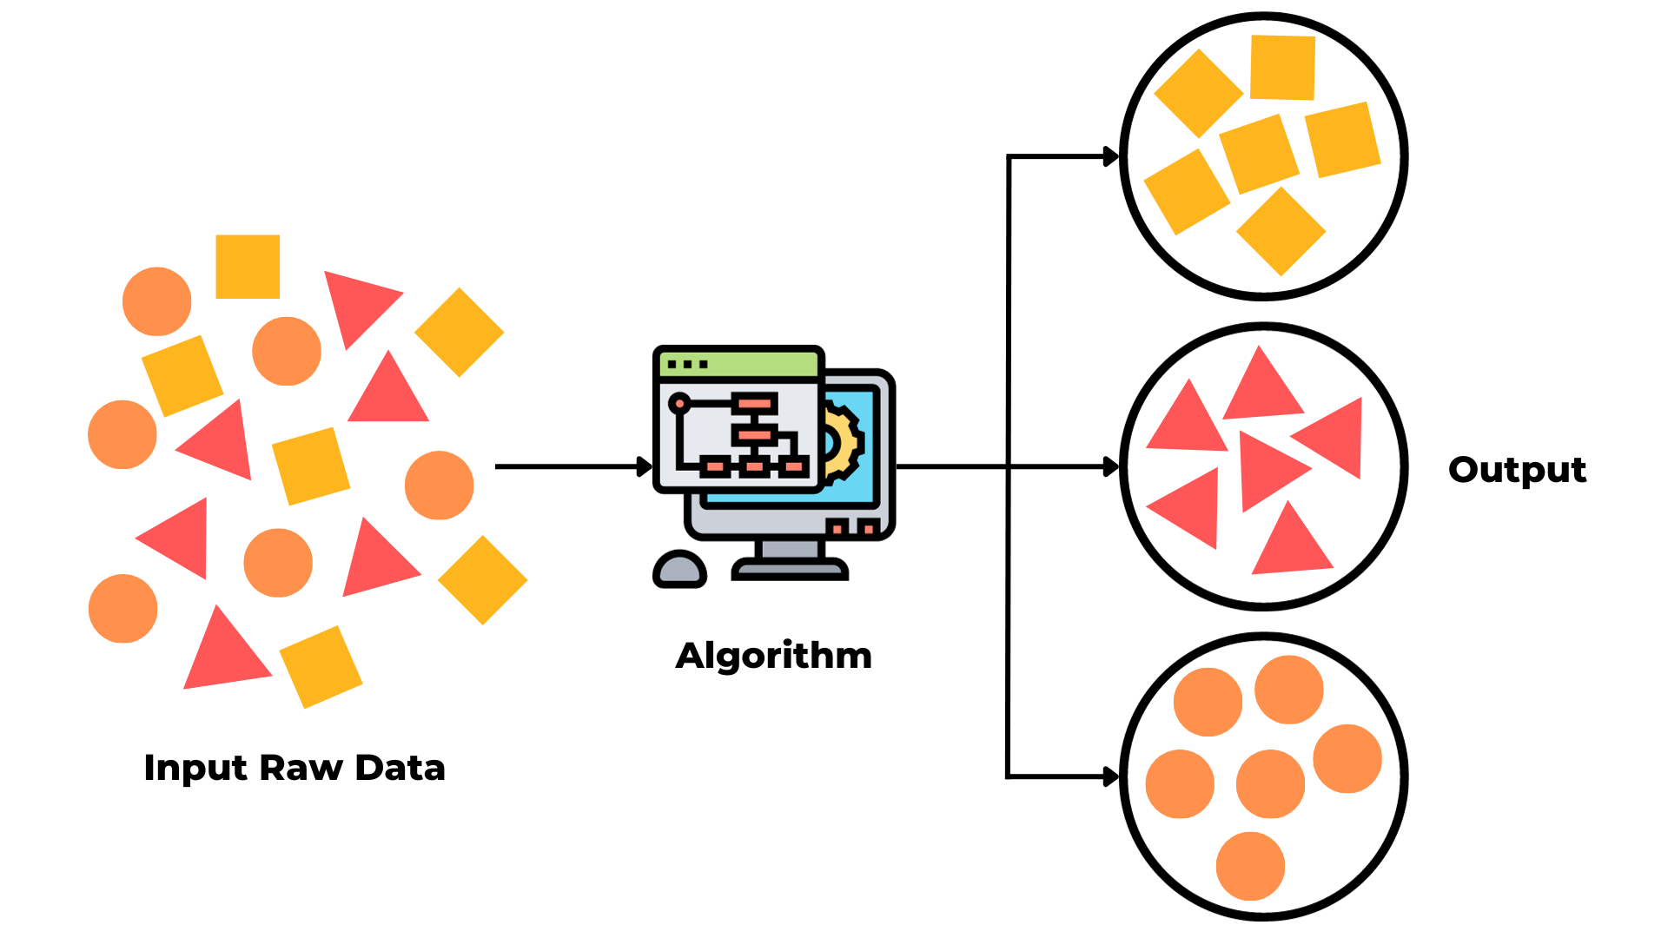

Slide 8

Reinforcement Learning:
The computer learns by taking actions and receiving feedback (rewards or penalties) based on those actions.
Example: teaching a child to ride a bicycle.

Slide 9
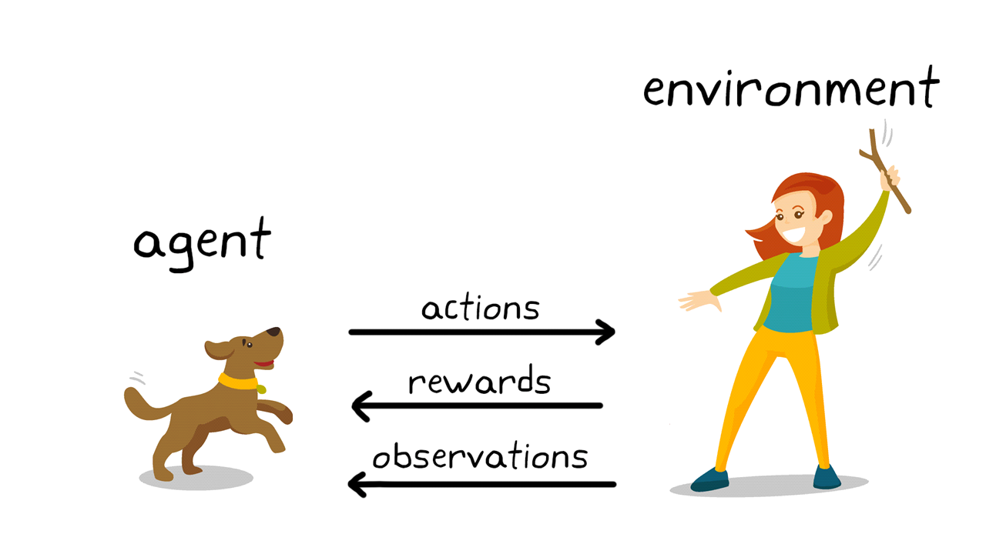

Slide 10
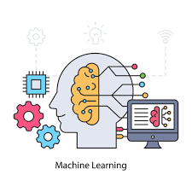
BENEFITS
Machine learning can help automate repetitive tasks, saving time and reducing the need for human involvement.
It helps make better decisions by analyzing large amounts of data and finding patterns humans might miss.
Machine learning helps create personalized experiences, like recommendations based on what you like.

Slide 11
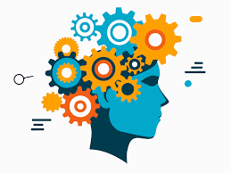
It can predict future events or trends, which helps in planning ahead.
Machine learning can work with huge amounts of data that would be too difficult for people to process manually.
It can keep improving over time by learning from new data, making it more accurate and effective

Slide 12
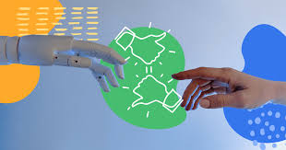
DISADVANTAGES
If the data is biased (unfair or unbalanced), the machine might make unfair decisions.
Machine learning often uses personal data, and if it’s not protected properly, people’s privacy could be at risk.
Machines might replace humans in certain jobs, causing some people to lose their jobs.

Slide 13
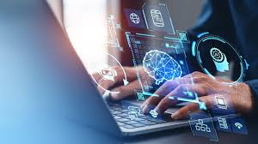
Some machine learning systems are like a “black box,” meaning it’s hard to know how they make decisions
Hackers can mess with the data or system to make it work wrongly, causing harm.
If we depend too much on machines, we might stop thinking for ourselves and make mistakes.
Machines might do things we didn’t expect, causing trouble.

